Slide 1

RUNGTA COLLEGE OF DENTAL SCIENCES & RESEARCH
TITLE OF THE TOPIC : Anatomical landmarks in Mandibular Arch
DEPARTMENT OF PROSTHODONTICS AND CROWN & BRIDGE

Slide 2
Specific learning Objectives
At the end of this presentation the learner is expected to know ;
Core areas* | Domain ** | Category #
Introduction | Cognitive | Must know
Various landmarks | Cognitive | Must know
Take Home Message | Cognitive | Must know
Conclusion | Cognitive | Must know
Reverences | Affective | Desired to know

Slide 3
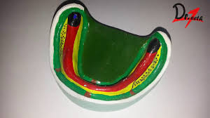
Table of Content
Introduction
Labial frenum
Labial vestibule
Buccal frenum
Buccal vestibule
Buccal shelf area
Retromolar pad
Pear shaped pad
Lingual frenum
Lingual Vestibule
Conclusion

Slide 4
Objectives
To make students familiar about various anatomical landmarks in mandibular arch and their significance.

Slide 5
Introduction
M.M Devan Dictum “Aim of a prosthodontist is not only the meticulous replacement of what is missing, but also perpetual preservation of what is present”
Complete denture must function in harmony with the remaining natural tissues so for the success, a through knowledge of the anatomy is a must.

Slide 6
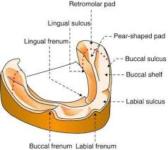
MANDIBULAR EDENTULOUS ARCH LAND MARKS

Slide 7
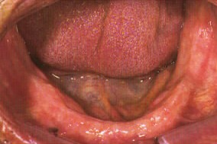
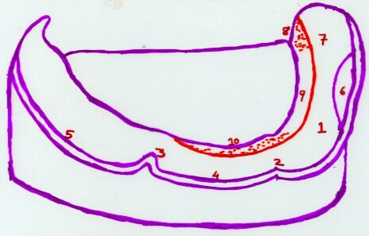
1. Labial Frenum:
It is a fibrous band covered by mucous membrane extending from labial aspect of residual alveolar ridge to the lower lip. It has no muscle attachment and is inserted in vertical direction.
It is best demonstrated by forward pull of lip.
It is accommodated by a groove in the mandibular denture.

Slide 8
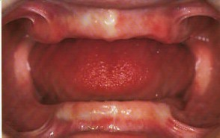
2. Labial vestibule:
The portion of the oral cavity bounded on one side by the teeth, gingiva and alveolar ridge (in the edentulous mouth the residual ridge) and on the other side by lips, anterior to the buccal frenum.
Boundaries:
1. Labial aspect of residual alveolar ridge
2.Muco labial alveolar fold.
3. Orbicularis oris muscle (lip)
The labial flange of the mandibular denture occupies this space.

Slide 9
3. Buccal Frenum:
Single or multiple folds of mucous membrane extending from buccal mucous membrane and reflects towards the slope of the crest of alveolar mucosa distal to canine region.
Reflection is in anterior posterior direction.
It overlies depressor anguli oris muscle.

Slide 10
4. Buccal Vestibule:
The portion of the oral cavity bounded on one side by the teeth, gingival, and alveolar ridge (in edentulous mouth residual ridge) and on the lateral side by the cheeks posterior to the buccal frenum.
It overlies fibres of buccinator muscle.
Buccal flange of the mandibular denture occupies this space.

Slide 11
5. Buccal shelf area:
Bounded laterally by external oblique ridge and internally by slope of residual ridge.
Bone in this area is very dense and is placed horizontal to stress land.
It is called as “primary Stress Bearing” area.
Forces can thus be directed more nearly at right angles to buccal shelf than any other area of support.

Slide 12
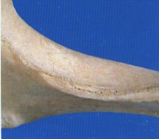
6. External oblique ridge:
It is a smooth ridge on the buccal surface of the body of the mandible that extends from the anterior border of the ramus with diminishing prominence downward and forward to the region of mental foramen.

Slide 13
7. Retromolar pad:
A mass of tissue comprised of non-keratinised mucosa located posterior to the retromolar papilla and over lying loose glandular connective tissue. This freely movable area should be differentiated from the pear shaped pad.
Pear Shaped Pad:
The most distal extension of attached keratinised mucosa overlying the mandibular ridge crest formed by the scarring pattern following extraction of the most posterior molar. It should be differentiated from retromolar area.

Slide 14
Retromolar pad:
Retromolar pad contains
fibres pterygomandibular raphae, fibres of superior pharyugeul constrictor, and buccinator muscles; fibers of temporal tendon and glandular tissue.
Boundaries:
Posteriorly – Temporalis tendons
Laterally – Buccinator Muscle
Medially – Pterygomandibular Raphe and superior constrictor of pharynx.
It must be covered by the denture base to aid in stability
It is important for support as it doesn’t resorb easily because of muscle attachments.

Slide 15
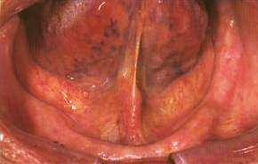
8. Lingual frenum:
This frenum overlies genioglossus muscle, which originates from superior genial tubercle.
Exhibit differing configurations in width and height.
Surgical intervention is indicated when it interferes with border extension and stability of mandibular denture.
Also in case of tongue tie (restricted tongue movements).

Slide 16
9. Sub-lingual fold:
The crescent shaped area on the floor of the mouth following the inner wall of the mandible and tapering towards the molar regions. It is formed by the sub-lingual gland and Submandibular duct.
It is the fold of mucous membrane from the tongue to residual ridge

Slide 17
10. Mylohypoid muscle:
It forms muscular floor of the mouth. Arises from the mylohyoid ridge and rises progressively on the body of mandible.
Mylohyoid muscle influences the mid and anterior portions of interior border of the lingual flange.
Length of the flange is determined by displaceability of the floor of the mouth and movements of the tongue.

Slide 18
11. Retromylohoid space:
An anatomic area in the Alveololingual sulcus just lingual to the retromolar pad bounded
anteriorly by the mylohyoid ridge, posteriorly by retromylohyoid curtain, inferiorly by the floor of the alveololingual sulcus and
lingually by the anterior tonsillar pillar
when the tongue is in a relaxed
position.
This space lies at the distal end of alveolo-lingual sulcus and provides bracing to the mandibular denture.

Slide 19
Lingual Vestibule
Divided into three Parts
Anterior vestibule
Middle vestibule
Distolingual vestibule
Anterior part of Lingual Vestibule
Also called sublingual crescent area
Structures present are
Genioglossus muscles
Lingual frenum
Anterior portion of sublingual gland

Slide 20
Middle part of Lingual Vestibule
Also called mylohyoid vestibule
Is the largest portion of lingual vestibule
Structures seen
Mylohyoid muscle
Sublingual gland
Posterior part of Lingual Vestibule
Also called lateral throat form or retromylohyoid fossa
Boundaries
Anteriorly – mylohyoid muscle
Laterally – pear shaped pad
Posteriorly – retromylohyoid curtain
Medially - tongue

Slide 21
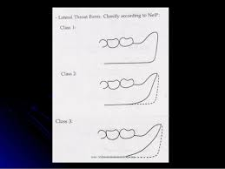
Posterior part of Lingual Vestibule
Also called lateral throat form or retromylohyoid fossa

Slide 22
Residual alveolar ridge:
The portion of the alveolar process and its soft tissue covering that remains after the removal of teeth.

Slide 23
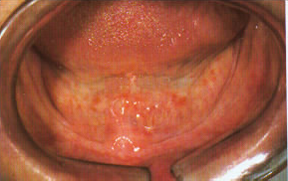
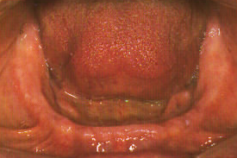

Slide 24
Video link
https://www.youtube.com/watch?v=M0dMzT3ASjM

Slide 25
TAKE HOME MESSEGE
The influence of the limiting structures in the mandible is more hence difficult to record them than in the maxilla.
Anatomical landmarks are important when making prosthesis.

Slide 26
REFERENCES
Prosthodontic treatment for edentulous patients. Zarb Bolender. 12th ed page
Essentials of complete denture. Winkler
Syllabus of Complete dentures Heartwell

Slide 27
Question & Answer Session
Primary supporting area of mandibular arch?
Releif areas of mandibular arch?
Boundaries of buccal shelf area?

Slide 28


